Slide 1
Vmt Onboard review
ZUO
17-JUNE-2016

Slide 2
CONTENTS
DJ / CDS
Powerflow
Cucumber
Jenkins

Slide 3
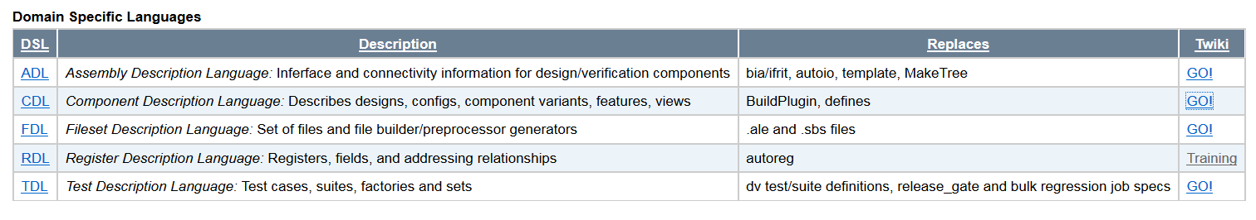
DJ/CDS: some basic definitions
Features
Interfaces
Registers
CDS: Component Distribution Structure
CDL: Component Description Language
DSL: Domain Specific Language
DJ: Distribution Jobs, a flow management tool
Component: a set of functional entities to realize specific task.
Flows
Source
Tools
Connection
Assembly
Component
Notes:
CDL 是 DSL中的一种. DSL说白了就是一种完成特殊任务的mini language. SQL和RE都是mini language.
A component in this case is a name scoped package of entities containing the set IP, SOC, shared toolset or library elements.
self-contained: Everything within the component is owned by the component
relocatable: Components cannot assume their location in the tree
DJ is a flow management tool which helps to automate verification tasks like simulation build and run_test.
Why CDS: 最终的目的还是为了IP的重用, 使重用时改动尽量小. CDS defines a standard directory structure for design and verification source and output areas Each IP's/SoC's must have to follow (CDS) so that the IP can be relocated and configured in many ways with minimum changes. Thus, the same IP can be used in multiple SoC's using minimum changes.
note: DSL with Python

Slide 4
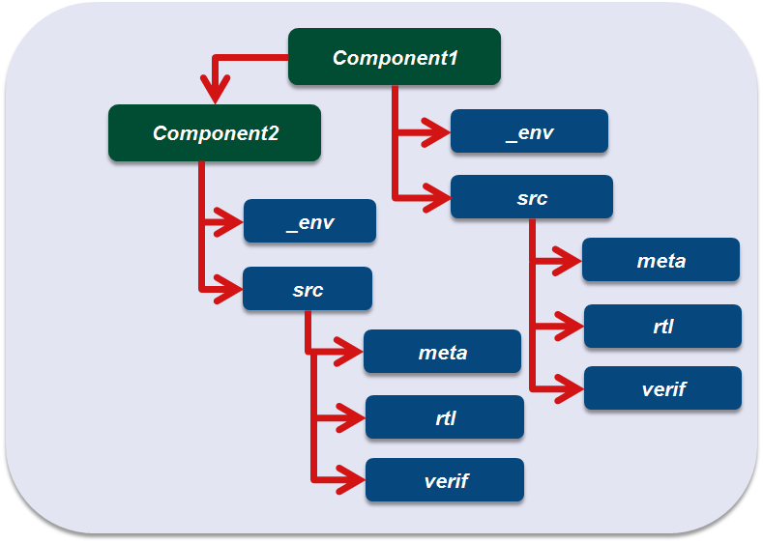
DJ/CDS: Directory structure
_env: bootenv information
meta: meta data and common tools
rtl: design RTL
verif: verification IP
meta: features -> feature info manifest -> config/design registers -> register info
Notes:
component是可以嵌套的. 如nbif -> bif_misc 以及 syshub两个component
_env: env.cfg / modulefile
meta: contains high level descriptions such as features, register, connectivity information, can be used to generate files for inclusion in RTL or verification.

Slide 5
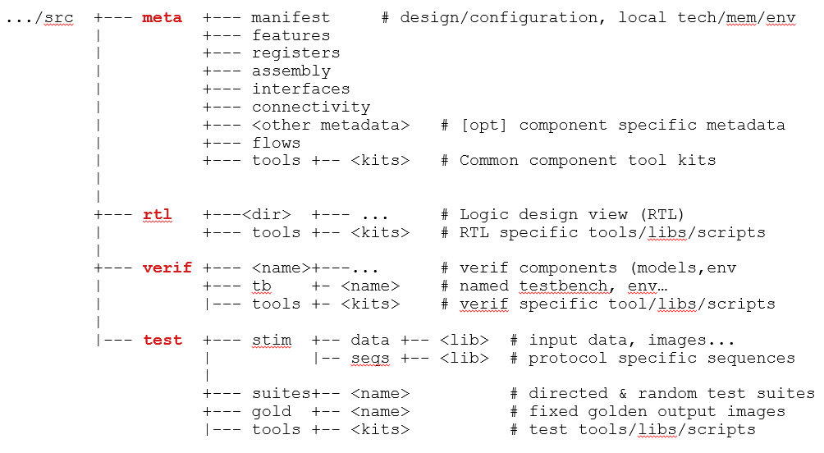
DJ/CDS: Directory structure - detail
Notes:
详细版的src路径结构

Slide 6
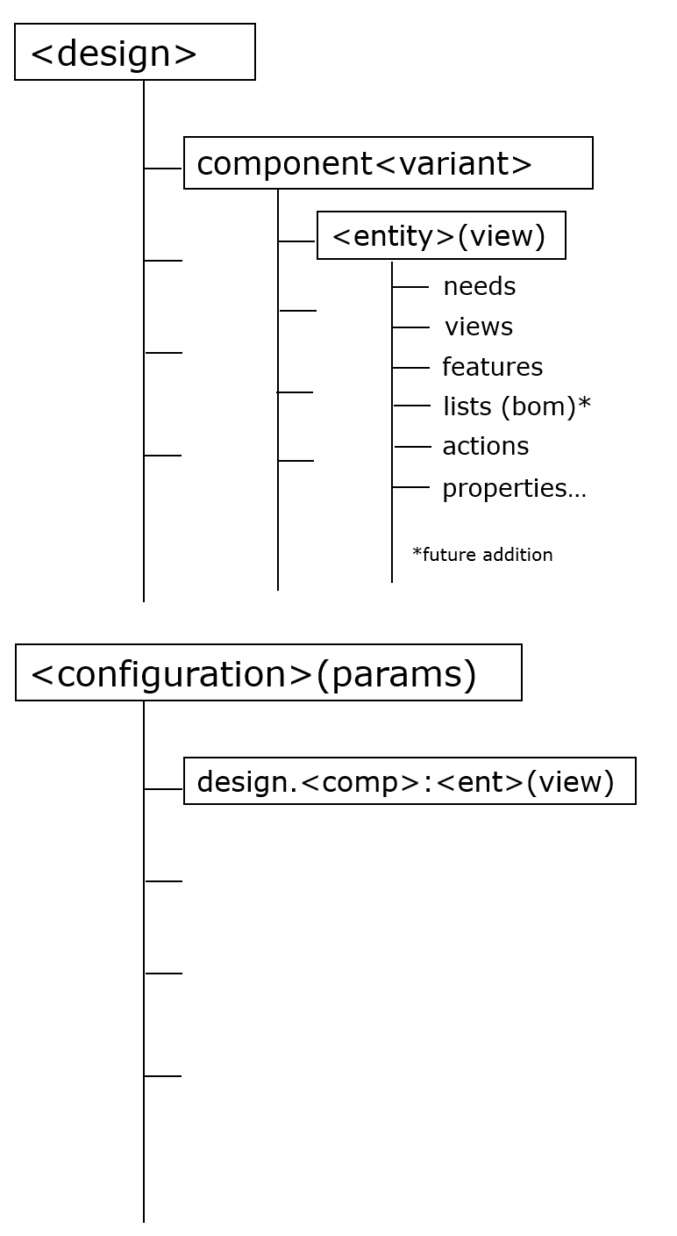
DJ/CDS: Variant / design / config / View
variant: Represents an encapsulated set of component features which describes a unique component disposition
design: A container that specifies a set of component and their assigned variants
config: A composite of declared components by view which specify the a specific testbench, build and run flows
view: Represents one or more abstractions of a component entity
Notes:
There are actually three degrees of freedom here – the first two component list and its variant are specified in the design, the third degree of freedom is ‘view’ and it’s specified in the configuration
如果把component看成一个类的话, variant有点像component在design中的实例.
sim_build_args都是通过config传的

Slide 7
DJ/CDS: album.dj / makefile
album.dj
component :comp1 do standard_design_comp_build :andgate_subblock1 do need infra::flows need stdgen::flows need infra::scripts need igputils::tools end end
Makefile
target ... : prerequisites ... command
Build macros: standard_build - build once in common standard_design_build - build once per design in <design>/common standard_design_comp_build - build once per component variant in design standard_design_config_build - build once per config in design
Notes:
album.dj的要点:
描述component及component相关的flow files
实际build时调用的还是make
Makefile的要点:
描述了编译的依赖关系
一旦写好，只需要一个make命令，整个工程完全自动编译，极大的提高了软件开发的效率
prerequisites中如果有一个以上的文件比target文件要新的话，command所定义的命令就会被执行

Slide 8
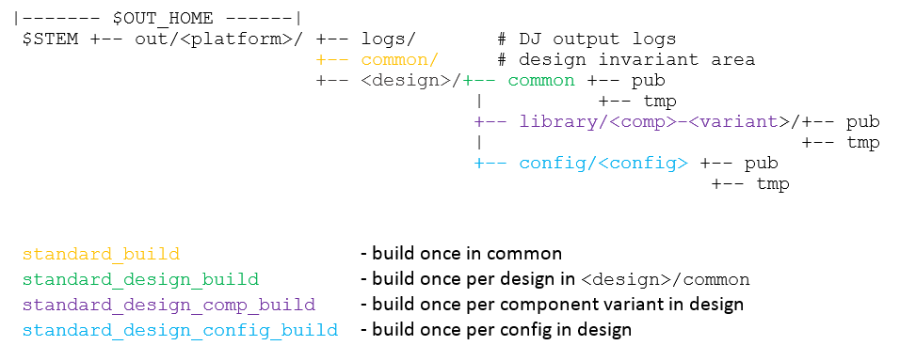
DJ/CDS: OUTputs

Slide 9
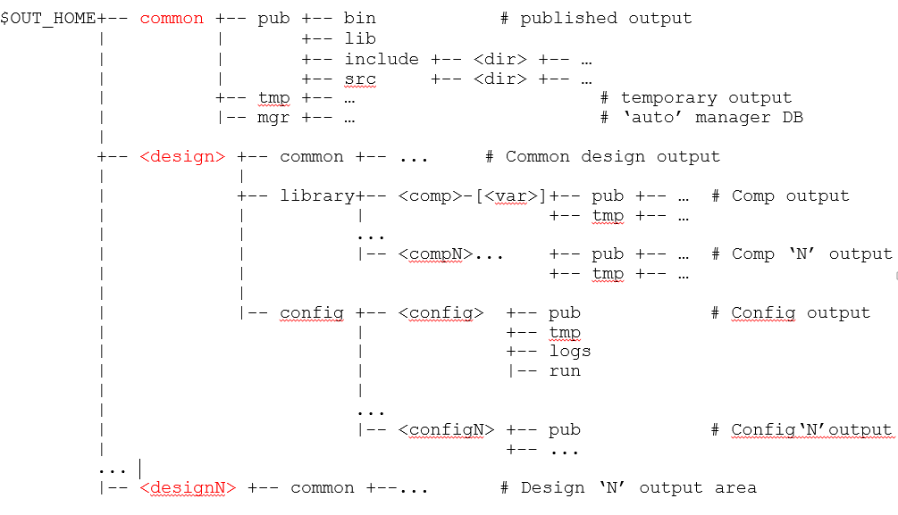
DJ/CDS: OUTputs
Notes:
对于powerflow来说, 比较重要的路径是:
$OUT_CMN_pub/src/meta/dfp
$OUT_DESIGN_pub/src/meta/dfp
$OUT_DESIGN_pub/src/meta/tools/dfp

Slide 10
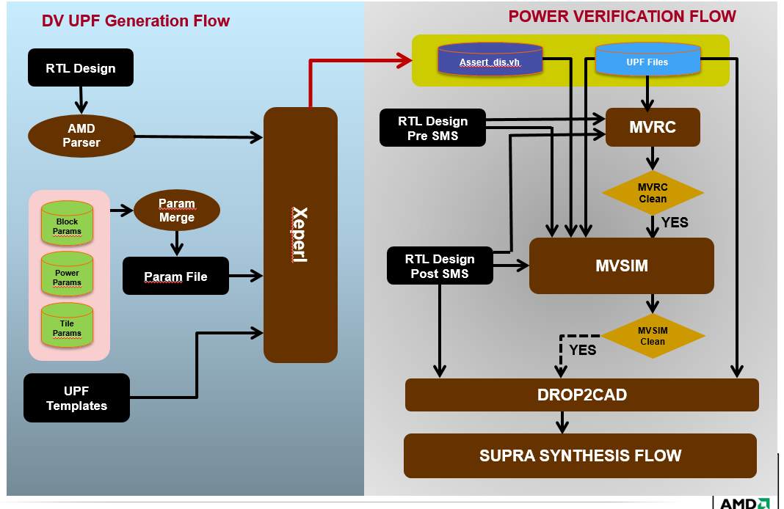
Power_flow: overview
UPF generation flow
Power verification flow
Notes:
UPF（Unified Power Format）由于硬件描述语言不支持对电源连接的描述，因此要仿真门控电源的工 作需要扩展RTL代码或者使用UPF（ Unified Power Format)来描述电源开关及其连接。UPF是一组 TCL命令，用于描述电源连接
1980s 当EDA行业刚开始为数字电路设计标准时, 功耗并不是主要考量. 大多数芯片都在单一电压下工作, 因此VHDL和Verilog均没有提供对功率结构的描述.
随着技术发展, 动态功耗变成了主要的设计限制, 才出现了UPF

Slide 11
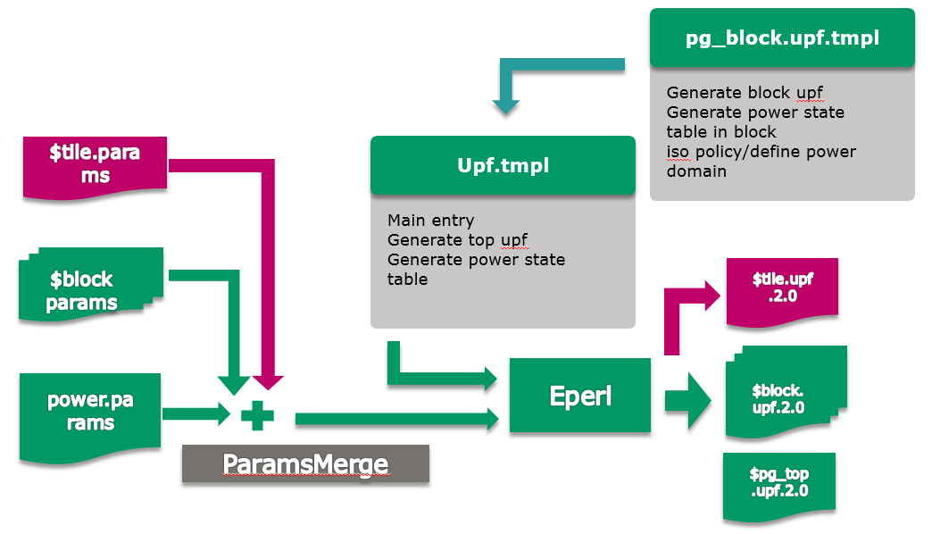
Power_flow: From Params To UPF
Notes:
Thanks to Angela for the pic

Slide 12
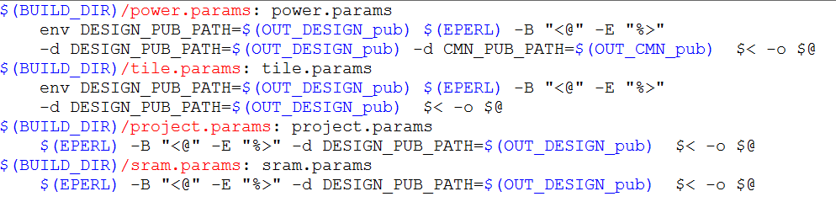
Power_flow : From Params To UPF
params/Makefile
Notes:
从代码上来看:
Makefile会先生成power.params, tile.params, project.params, sram.params
将params本身当作template处理. 事先放入了 OUT_DESIGN_pub和OUT_CMN_pub
为了与本身的params加以区分, Xeperl标记用的是 <@ %>

Slide 13
Power_flow: From Params To UPF
power.params, tile.params, project.params, sram.params
templates
XEPERL
Makefile
$OUT_CMN_pub,
$OUT_DESIGN_pub
UPF
XEPERL
params
pg_block.params,
default.params,
…
XEPERL
user input

Slide 14
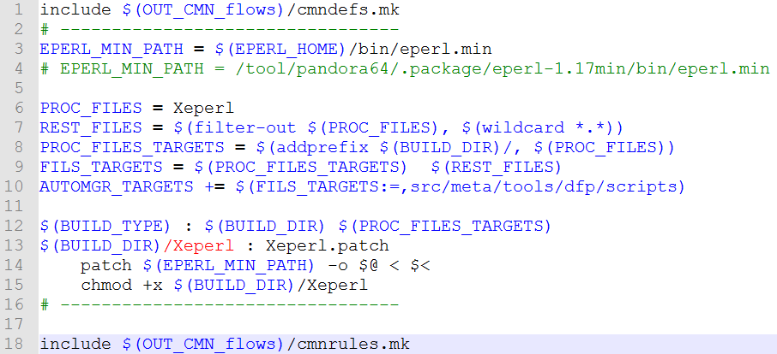
DJ/CDS: makefile
Purpose: to patch eperl.min to Xeperl before Xeperl is called the first time.
File: powerflow_pkg/src/bin/Makefile
Notes:
目的: 解决eperl.min的版权问题 (并没有)
最初希望加在mut_upf_param_flow.pl里. 出现报错: XEPERL找不到! 因为power.params / tile.params / project.params / sram.params的生成在mut_upf_param_flow.pl被调用之前就先生成了 (生成过程需要调用Xeperl. 可顺便看一下 src/params/Makefile
别忘记同时要在params/album.dj中打开dfp_params对dfp_scripts的need关系.

Slide 15
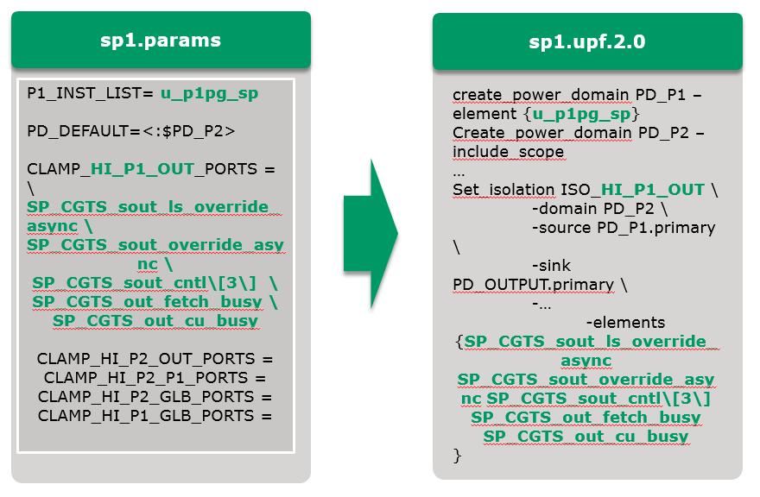
Power_flow: From Params To UPF – Formats

Slide 16
Power_flow: output tree
$OUT_HOME /common/pub/src/meta/dfp/tools #common scripts, templates
| /scripts
| /templates
|
/<design>/common/pub/src/meta
| /tools/dfp/params #common params
| |
| /dfp
| /params #project params
| /amdparse
|
|
/library/<comp>-[<var>]/pub/src/meta/dfp/block_params

Slide 17
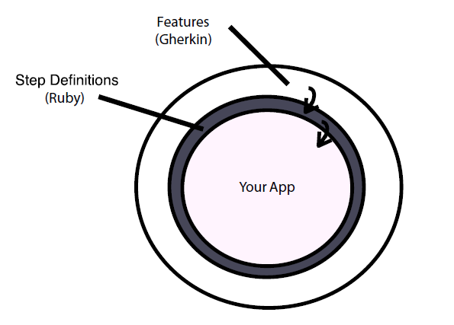

cucumber
Features: nature language
Step Definitions: ruby
Your App
Notes:
提供了自然语言与单元功能测试的接口 (你咋不用代码注释呢, 因为:)
节省了重复代码. (step_definition.rb只有一个文件哦)

Slide 18
cucumber
how connectivity flow get it done:
features:
basic
generators
hierarchy_macro
repeater
tile_build
vdci
step_definition
golden
Notes:
features 的分类
step定义的统一
golden做比较

Slide 19
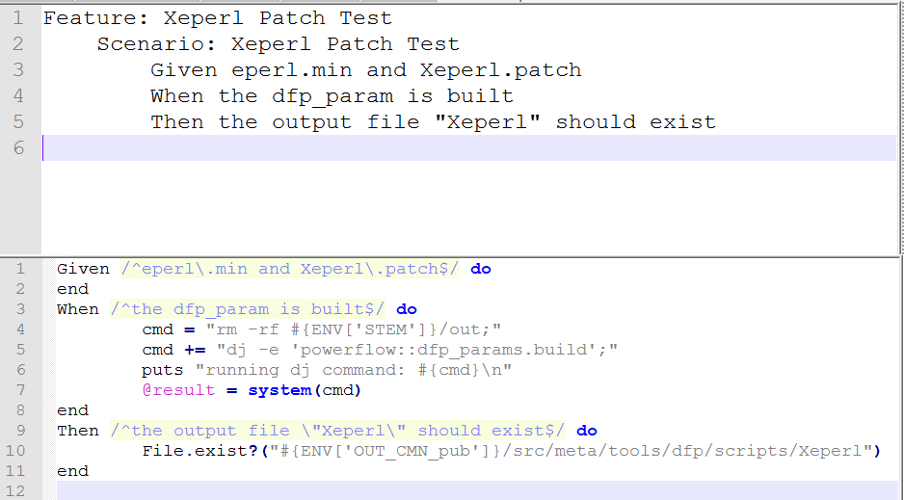
cucumber
A simple cucumber test for powerflow xeperl.patch feature

Slide 20
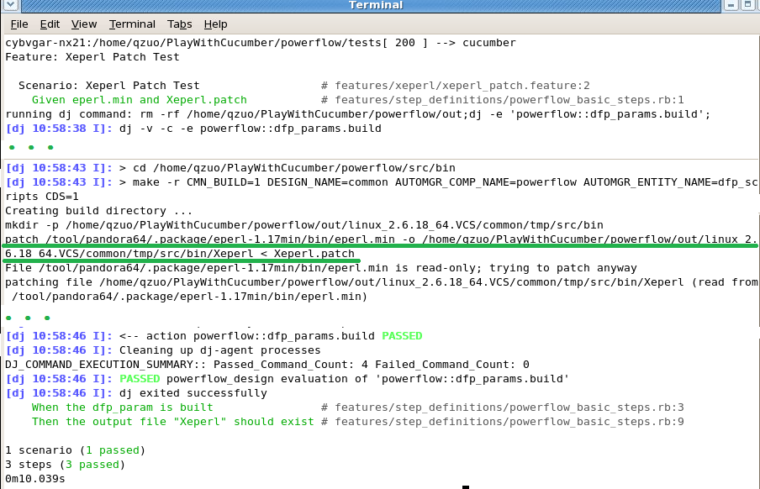
cucumber: test result

Slide 21
Jenkins: important configurations
project name
MISC_MODULES
PERFORCE_WORKSPACES (advanced: directory)
CL: change list
Label Expression
Excute shell: command
/proj/verif_release_ro/jenkins_lib/current/Jenkins_lib.sh

Slide 22
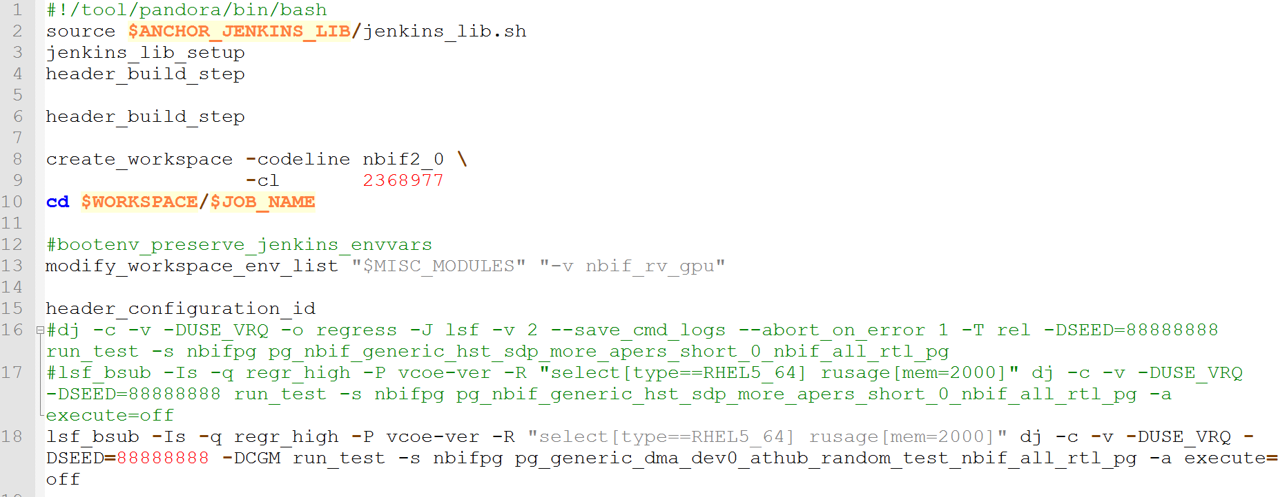
Jenkins: command

Slide 23
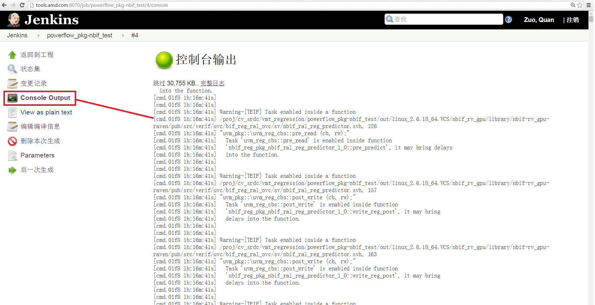
Jenkins: output and debug
Console output:

Slide 24
Thank you!

